Slide 1

OBSTACLE-AVOIDING
ROBOT

Slide 2
OUR TEAM
Abdullah Etman
Anas Dorgham

Slide 3

CONTENT
01
INTRODUCTION
02
COMPONENTS
03
METHODOLGY
04
SCHEMATIC
05
CODE & DRIVERS
06
TESTING

Slide 4
INTRODUCTION
This project focuses on the development of an obstacle-avoiding robot designed to navigate autonomously through its environment. The robot identifies obstacles in its path and adjusts its direction to avoid collisions, ensuring smooth movement. Using sensor feedback, it continuously monitors the distance between itself and nearby objects, making real-time decisions to move forward, turn right, or left, or perform a turnabout.
This dynamic behavior allows for effective navigation in complex environments without human intervention. The robot’s algorithm prioritizes safety and efficiency by adjusting its course based on proximity to obstacles.

Slide 5
COMPONENTS

Slide 6
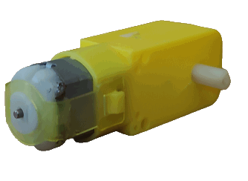
COMPONENTS
2x DC Motor

Slide 7
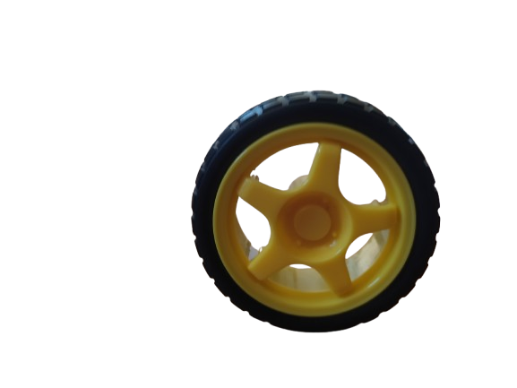
COMPONENTS
2x DC Motor
2x Wheel with Tier

Slide 8
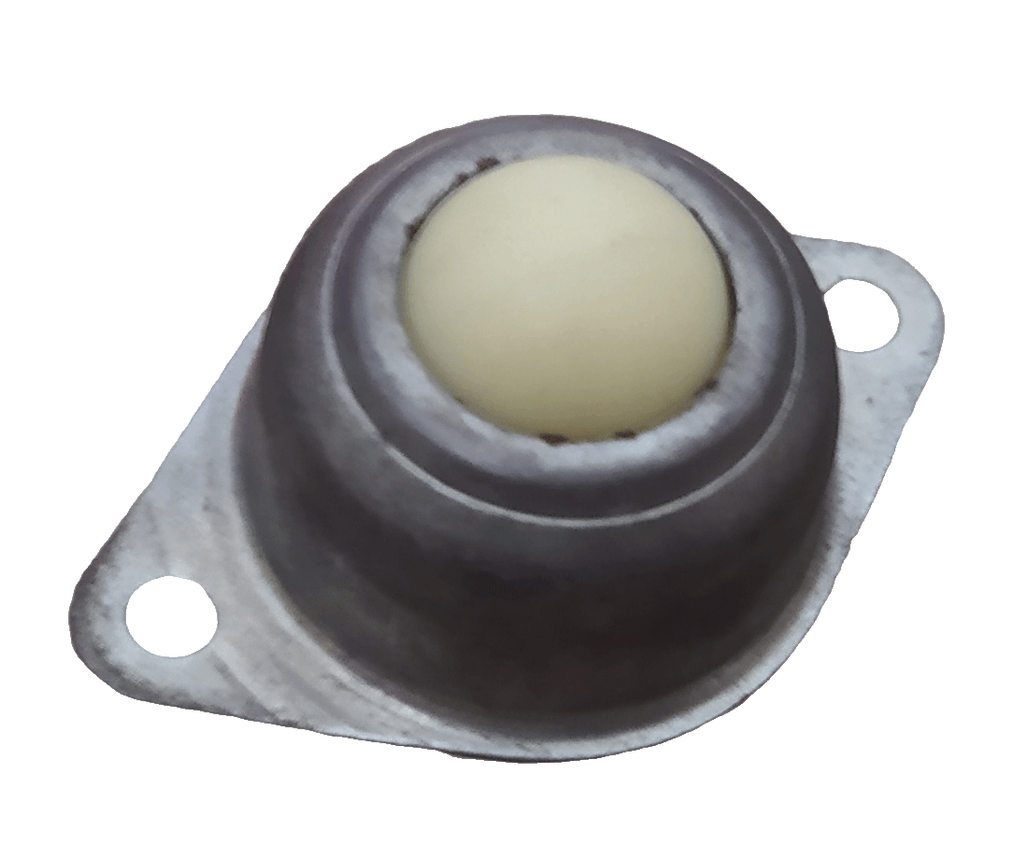
COMPONENTS
2x DC Motor
2x Wheel with Tier
1x Caster Wheel

Slide 9
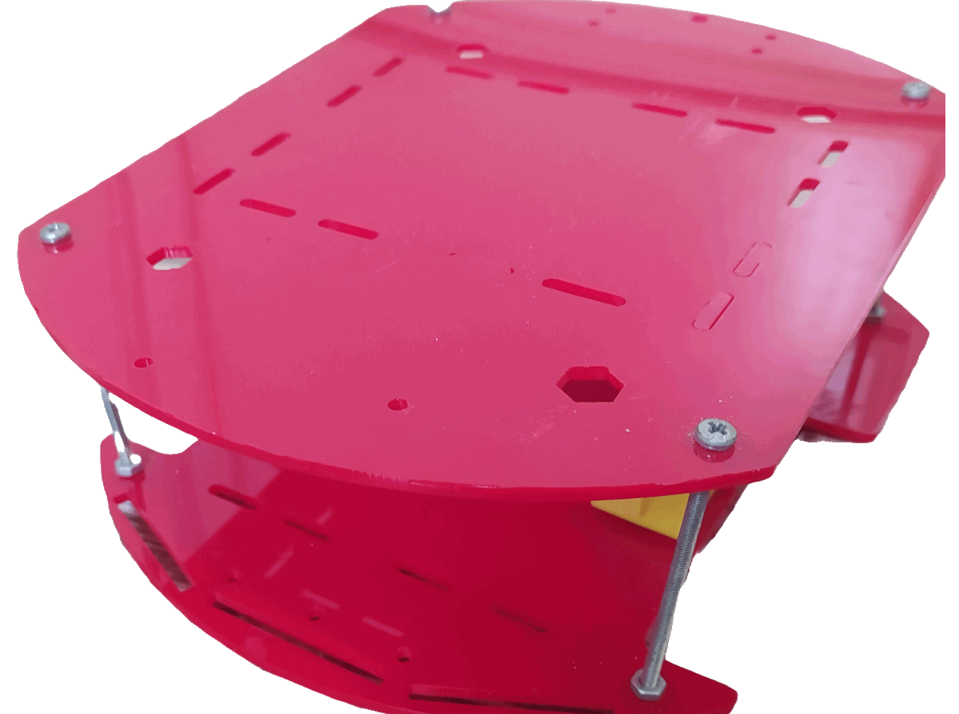
COMPONENTS
2x DC Motor
2x Wheel with Tier
1x Caster Wheel
2x Car Chassis

Slide 10
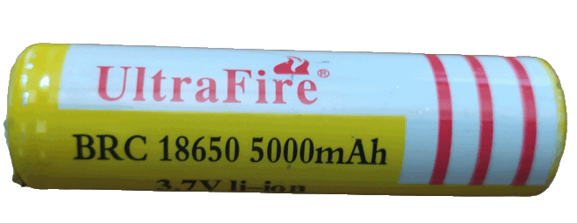
COMPONENTS
2x DC Motor
2x Wheel with Tier
1x Caster Wheel
2x Car Chassis
4x 3.7V Li-ion Battery

Slide 11
COMPONENTS
2x DC Motor
2x Wheel with Tier
1x Caster Wheel
2x Car Chassis
4x 3.7V Li-ion Battery
1x Buck Converter (Step-down Converter)
Front View
Rear View

Slide 12
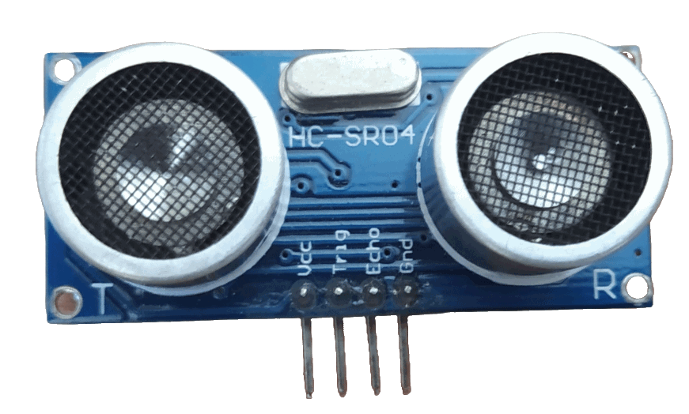
COMPONENTS
2x DC Motor
2x Wheel with Tier
1x Caster Wheel
2x Car Chassis
4x 3.7V Li-ion Battery
1x Buck Converter
1x Ultrasonic Sensor

Slide 13
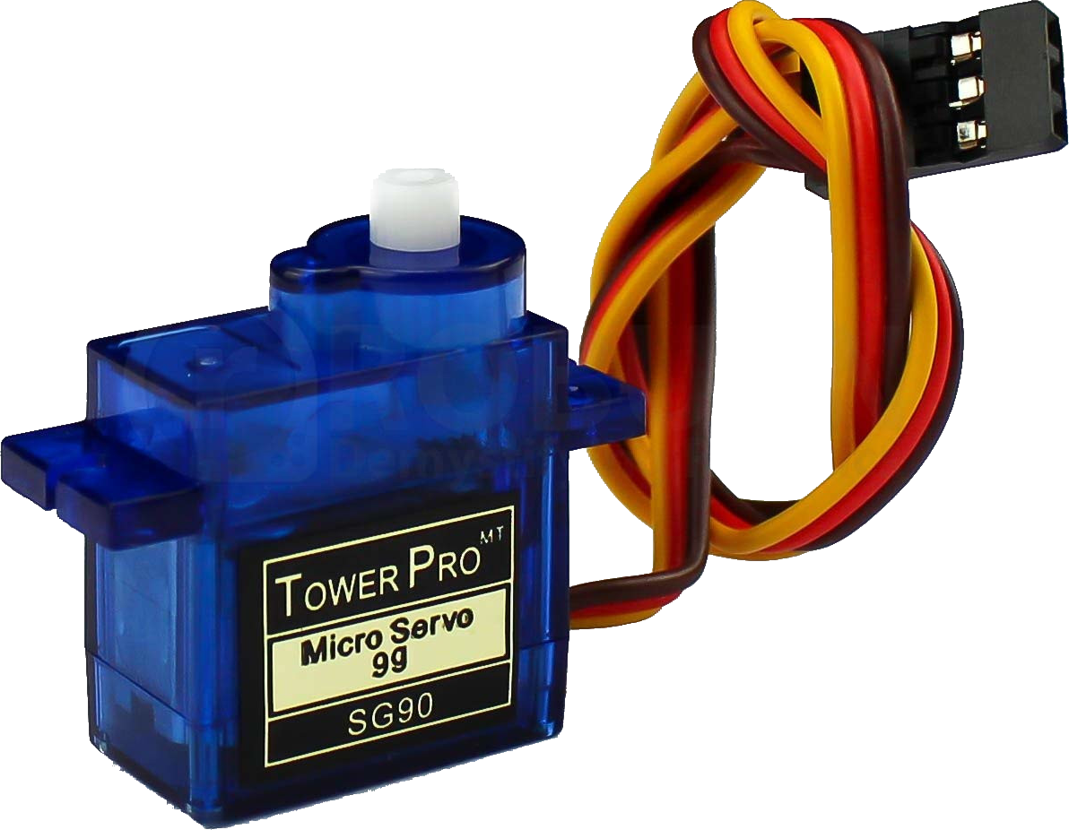
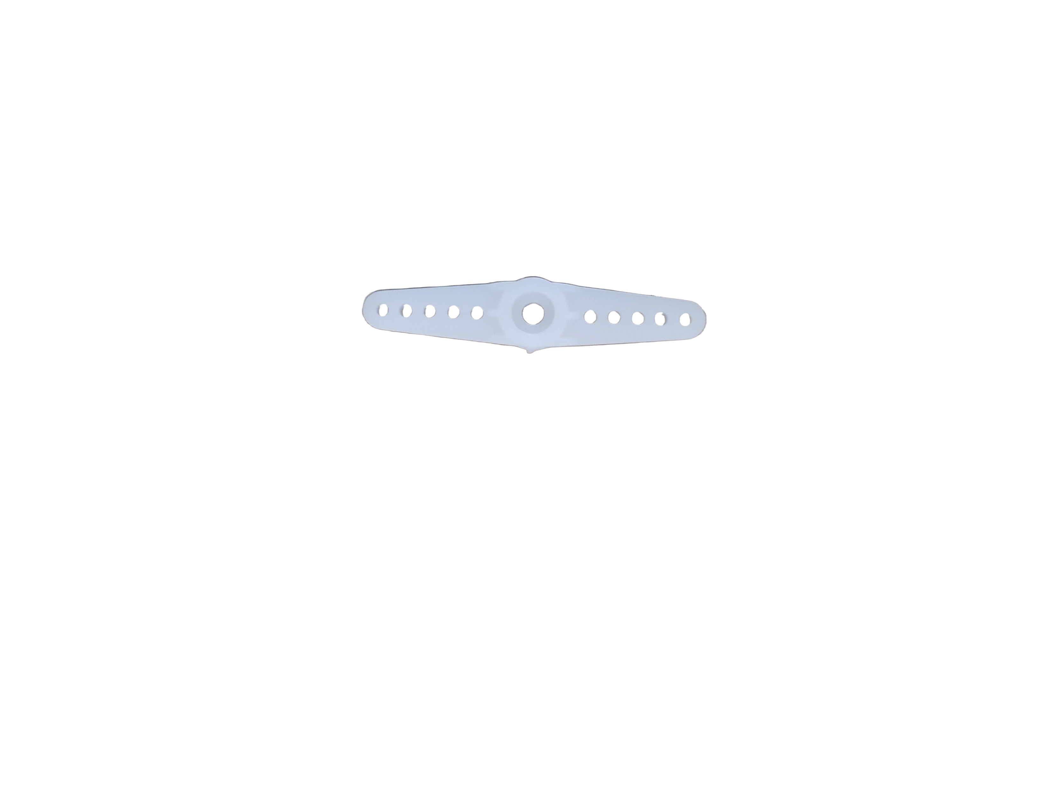
COMPONENTS
2x DC Motor
2x Wheel with Tier
1x Caster Wheel
2x Car Chassis
4x 3.7V Li-ion Battery
1x Buck Converter
1x Ultrasonic Sensor
1x Servo Motor (with its arm)
AnasBHX, CC BY-SA 4.0 https://creativecommons.org/licenses/by-sa/4.0, via Wikimedia Commons
Edited: Background removed, and shadow added.
Servo Motor’s Arm

Slide 14
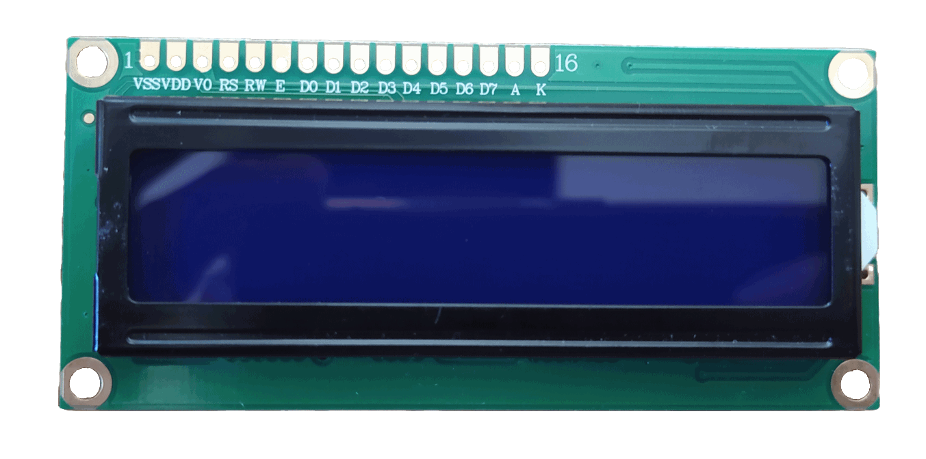
COMPONENTS
2x DC Motor
2x Wheel with Tier
1x Caster Wheel
2x Car Chassis
4x 3.7V Li-ion Battery
1x Buck Converter
1x Ultrasonic Sensor
1x Servo Motor (with its arm)
1x LCD (16x2)

Slide 15
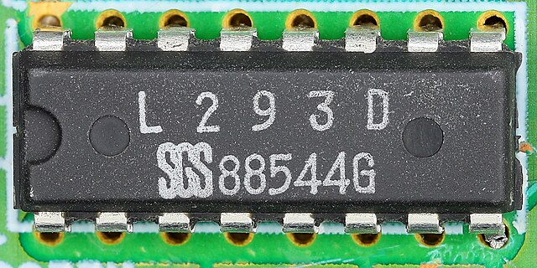
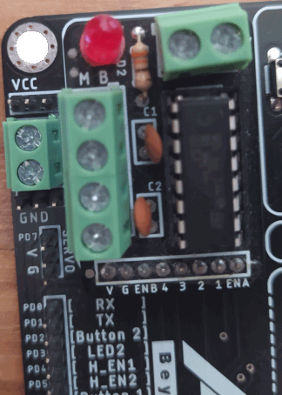
COMPONENTS
2x DC Motor
2x Wheel with Tier
1x Caster Wheel
2x Car Chassis
4x 3.7V Li-ion Battery
1x Buck Converter
1x Ultrasonic Sensor
1x Servo Motor (with its arm)
1x LCD (16x2)
1x L293D (with 2x 100nF capacitors, 1x 330Ω resistors and 1x LED)
Mister rf, CC BY-SA 4.0 https://creativecommons.org/licenses/by-sa/4.0, via Wikimedia Commons. Edited: Shadow added.
They are usually sold as a whole unit.

Slide 16
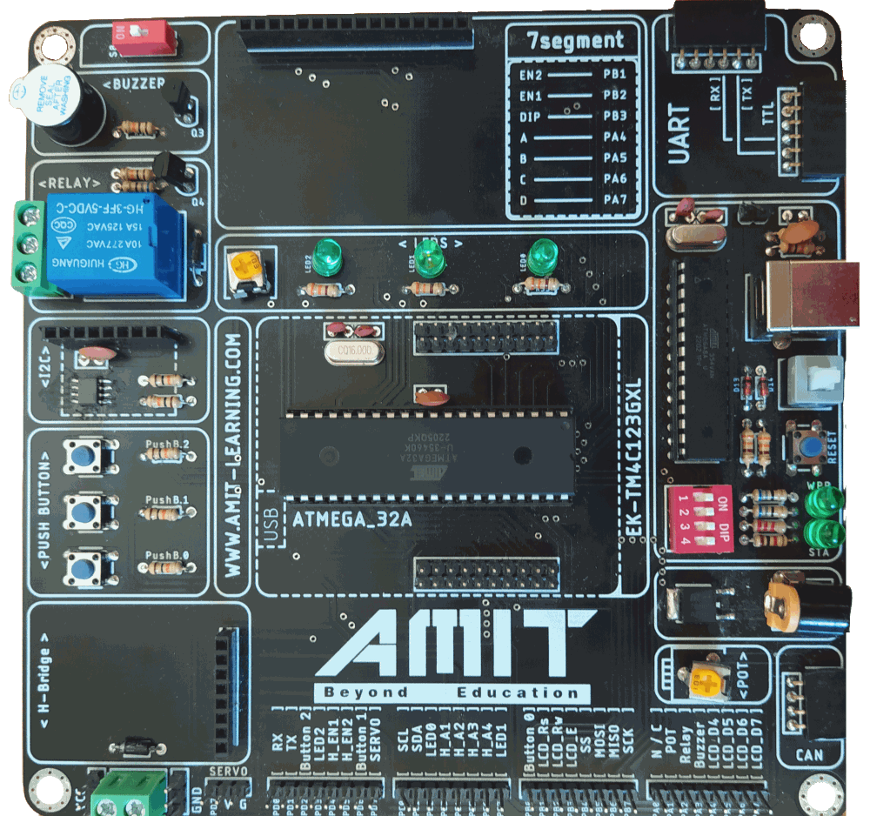

COMPONENTS
2x DC Motor
2x Wheel with Tier
1x Caster Wheel
2x Car Chassis
4x 3.7V Li-ion Battery
1x Buck Converter
1x Ultrasonic Sensor
1x Servo Motor (with its arm)
1x LCD (16x2)
1x L293D (with 2x 100nF capacitors, 1x 330Ω resistors and 1x LED)
1x AMIT Kit
It includes ATmega32A, Crystal Oscillators, Resistors, Capacitors, LEDs, a Reset Push Button, a Power On/Off Switch, potentiometers and Power Supply Ports)

Slide 17
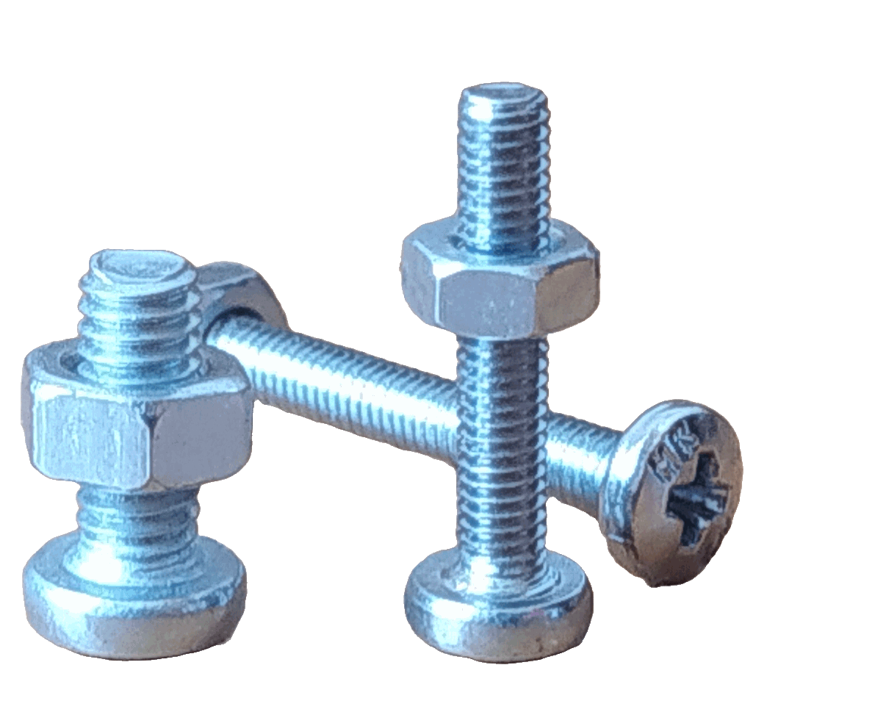
COMPONENTS
2x DC Motor
2x Wheel with Tier
1x Caster Wheel
2x Car Chassis
4x 3.7V Li-ion Battery
1x Buck Converter
1x Ultrasonic Sensor
1x Servo Motor (with its arm)
1x LCD (16x2)
1x L293D (with 2x 100nF capacitors, 1x 330Ω resistors and 1x LED)
1x AMIT Kit
Screws and Nuts

Slide 18
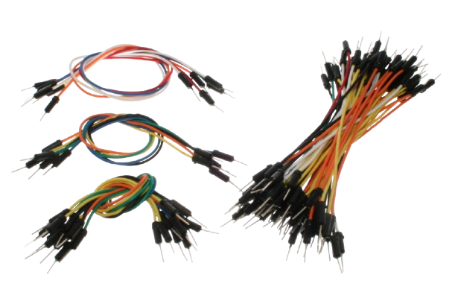
COMPONENTS
2x DC Motor
2x Wheel with Tier
1x Caster Wheel
2x Car Chassis
4x 3.7V Li-ion Battery
1x Buck Converter
1x Ultrasonic Sensor
1x Servo Motor (with its arm)
1x LCD (16x2)
1x L293D (with 2x 100nF capacitors, 1x 330Ω resistors and 1x LED)
1x AMIT Kit
Screws and Nuts
Wire Jumpers
oomlout, CC BY-SA 2.0 https://creativecommons.org/licenses/by-sa/2.0, via Wikimedia Commons
Edited: Background removed, and shadow added.

Slide 19
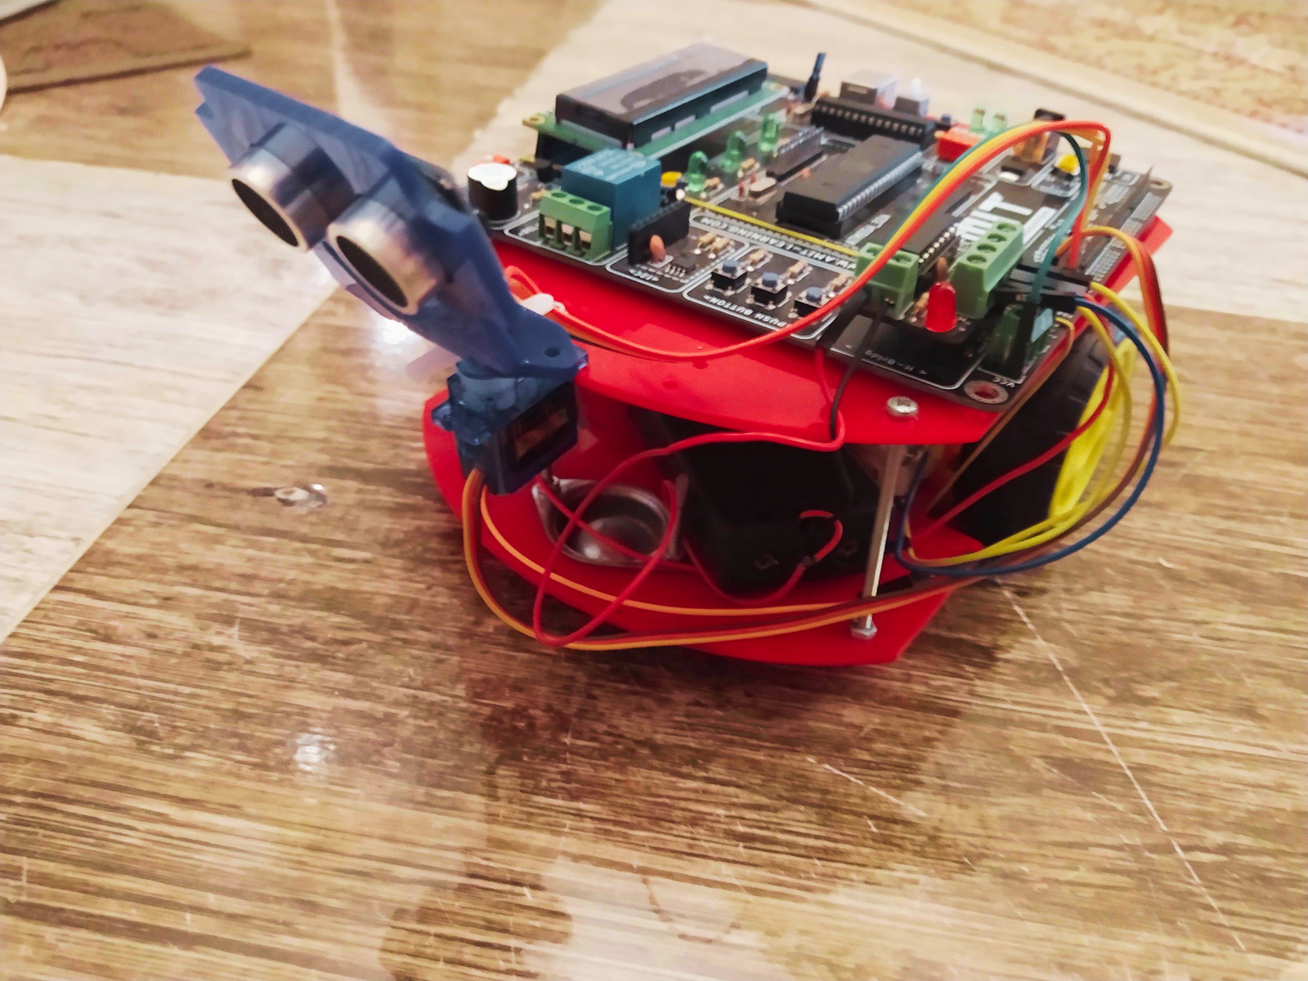
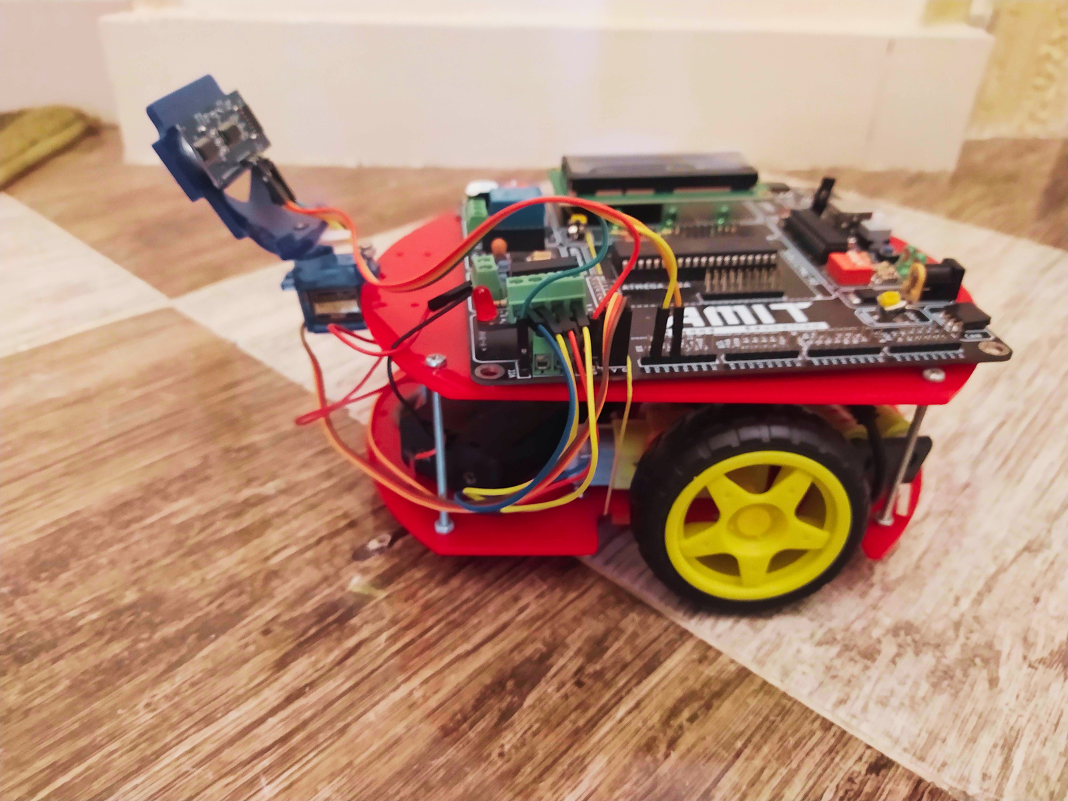
METHODOLOGY
The robot uses an ultrasonic sensor mounted on a servo motor to scan its surroundings. Initially, the servo motor is centered, with the ultrasonic sensor facing forward. If no obstacle is detected within a set threshold, the robot moves forward, displaying the direction on an LCD.
When an obstacle is detected, the robot stops, and the servo motor rotates the ultrasonic sensor to the right to measure the distance in that direction. If the right side is clear, the robot turns right and resumes forward movement.

Slide 20
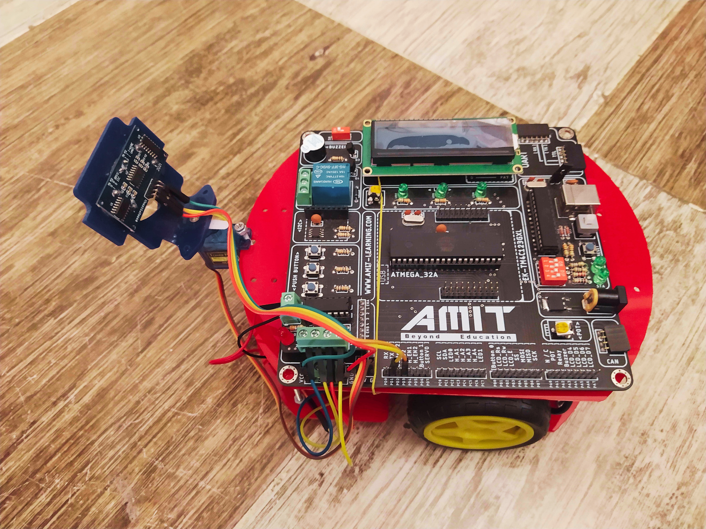
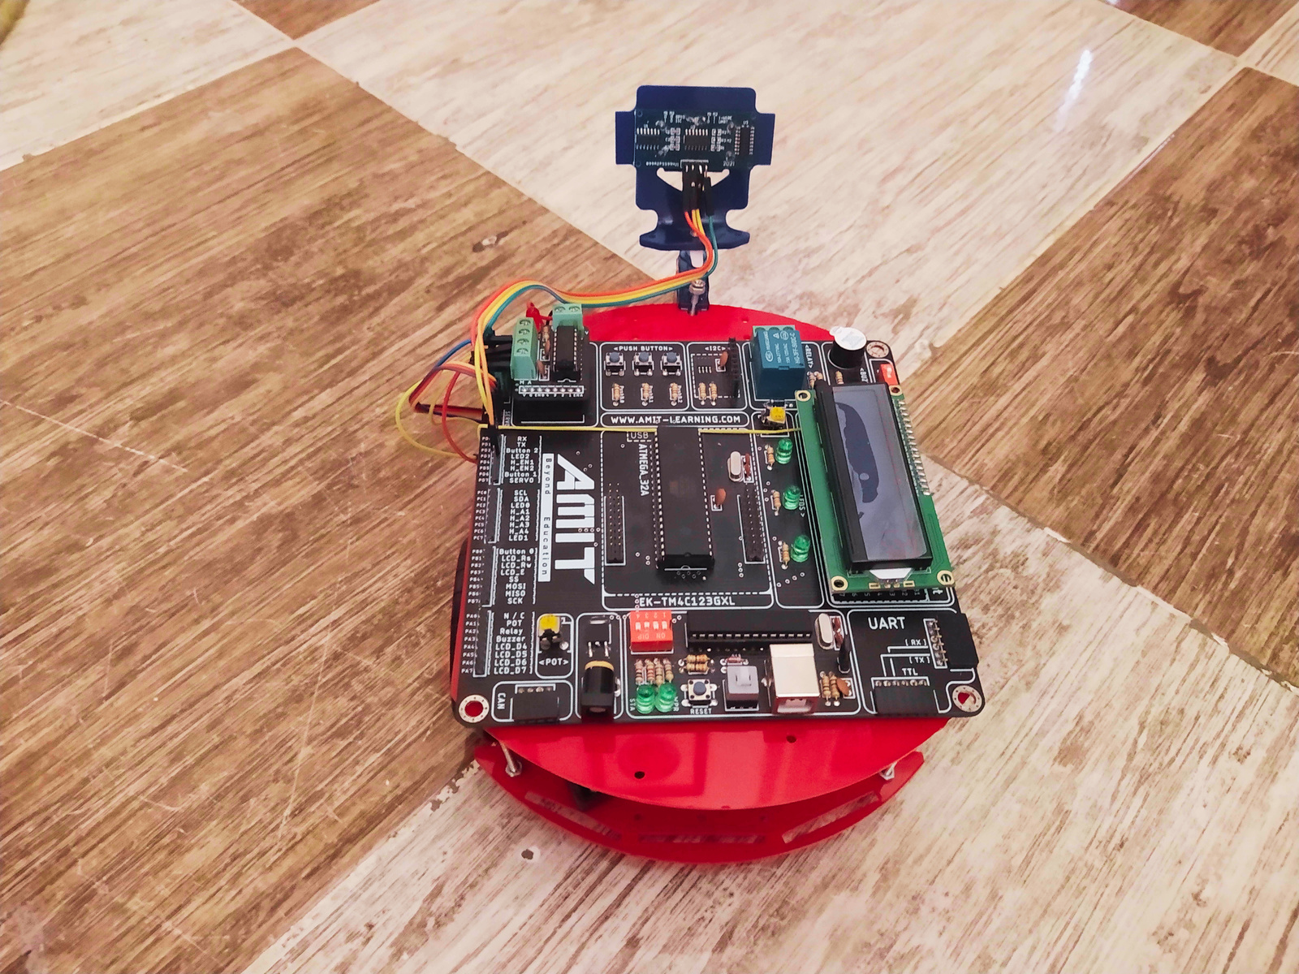
METHODOLOGY
If the right side is blocked, the servo motor rotates the ultrasonic sensor to the left. If the left side is clear, the robot turns left and continues forward.
If both sides are blocked, the robot performs a 180-degree turn and proceeds on a new path. The servo motor then re-centers the ultrasonic sensor, and the process repeats.

Slide 21
SCHEMATIC
The next slide shows the circuit schematic, demonstrating how to build the circuit from scratch, even without a kit.

Slide 22

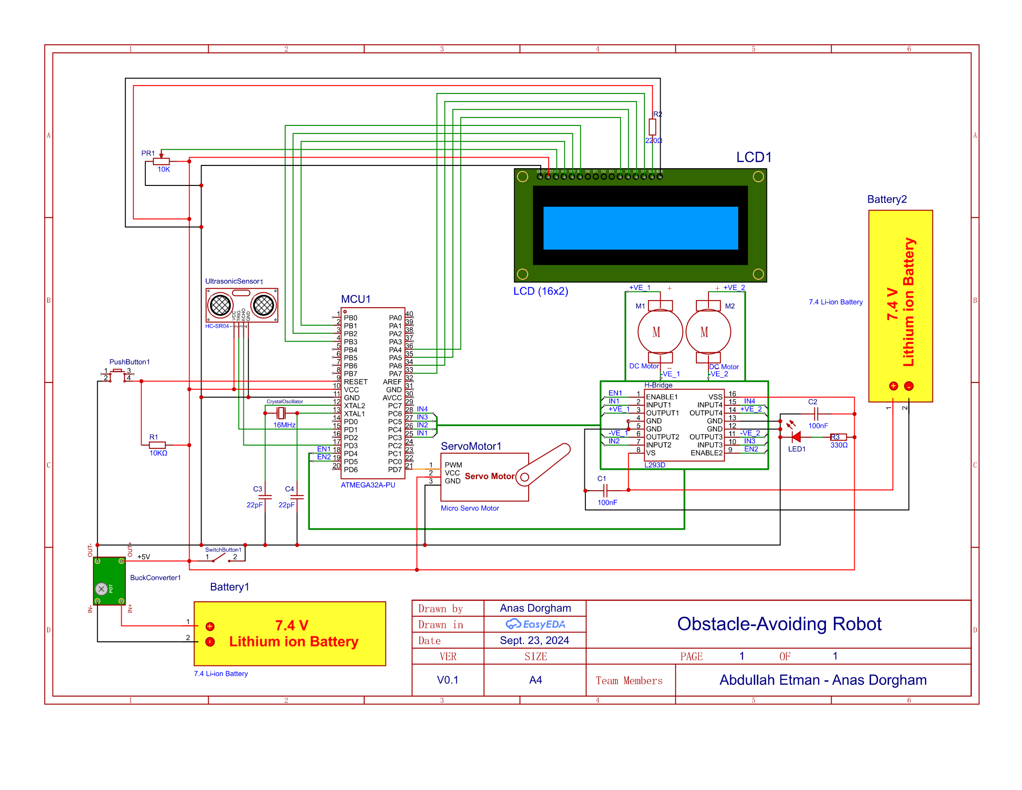

Slide 23

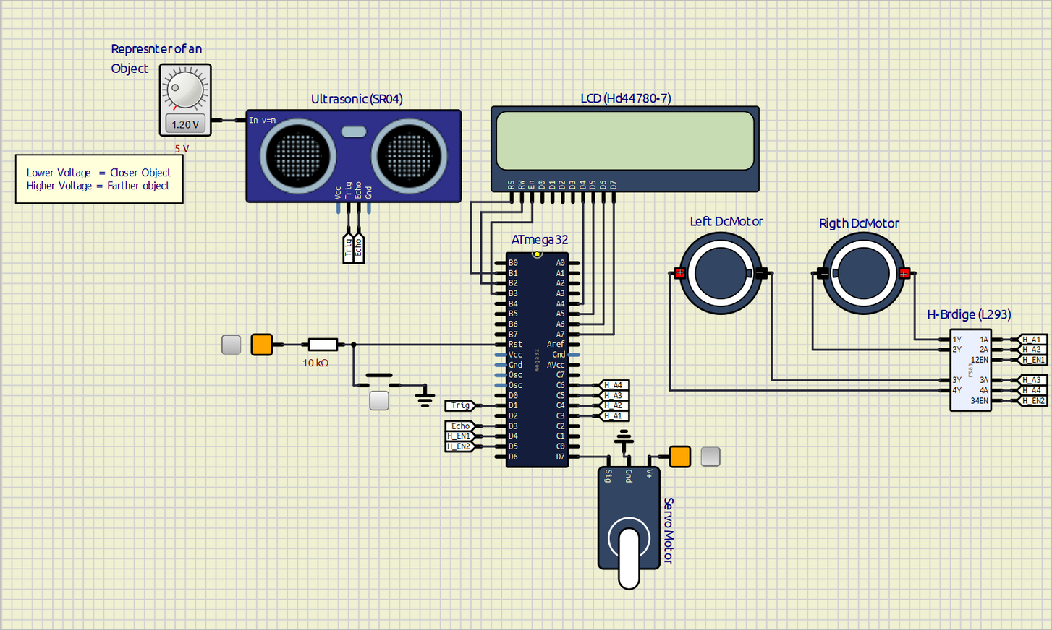
Here is the circuit in SimulIDE:

Slide 24
CODE & DRIVERS
The main code and drivers are uploaded into this repository:
few
EMB-ALEX-41-OBSTACLE-AVOIDING-ROBOT

Slide 25
TESTING
The link below is for a video showing the code being tested on the robot.
few
OBSTACLE-AVOIDING ROBOT.MP4

Slide 26
THANKS FOR WATCHING

